Slide 1



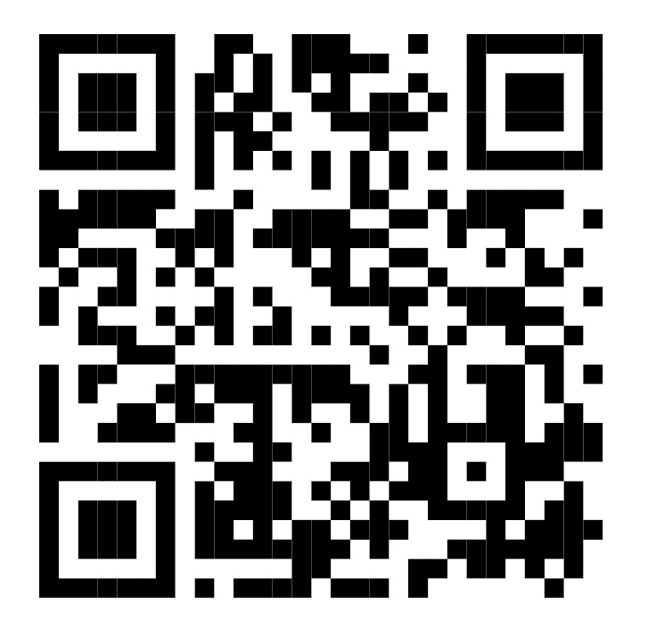

85th FIP WORLD CONGRESS OF PHARMACY
AND PHARMACEUTICAL SCIENCES
Kuala Lumpur, Malaysia
12 – 15 September 2027
Supported by:
The Malaysian Pharmacists Society (MPS)
“Bridging worlds: Global knowledge,
local realities and better care”
For more information,
visit congress website:
Kualalumpur2027.fip.org

Slide 2

Subthemes:
Subtheme 1
Subtheme 2
Subtheme 3
Global evidence, shared responsibility
Local contexts matter
Resilient health systems in action
Important dates:
6 January 2027: Registration opening
17 March 2027: Abstract submission deadline
2 June 2027: Early registration fee deadline

